Slide 1
Chapter 7 More SQL: Complex Queries

Slide 2
Content
Complex SQL Retrieval Queries
Views in SQL
Schema Change Statements in SQL

Slide 3
More Complex SQL Retrieval Queries
Comparisons Involving NULL and Three-Valued Logic
NULL is used to represent a missing value, but it usually has one of three different interpretations:
1. Value unknown (value exists but is not known, or it is not known whether or not the value exists)
2. Value not available (value exists but is purposely withheld),
3. Value not applicable (the attribute does not apply to this tuple or is undefined for this tuple).
Unknown value
A person’s date of birth is not known, so it is represented by NULL in the database.
An example of the other case of unknown would be NULL for a person’s home phone because it is not known whether or not the person has a home phone.
Not applicable attribute
An attribute Last College Degree would be NULL for a person who has no college degrees because it does not apply to that person.
Unavailable or withheld value
A person has a home phone but does not want it to be listed, so it is withheld and represented as NULL in the database.

Slide 4
More Complex SQL Retrieval Queries
Comparisons Involving NULL and Three-Valued Logic
When a record with NULL in one of its attributes is involved in a comparison operation, the result is considered to be UNKNOWN (it may be TRUE or it may be FALSE).
SQL uses a three-valued logic with values TRUE, FALSE, and UNKNOWN instead of the standard two-valued (Boolean) logic with values TRUE or FALSE.
It is therefore necessary to define the results (or truth values) of three-valued logical expressions when the logical connectives AND, OR, and NOT are used.

Slide 5
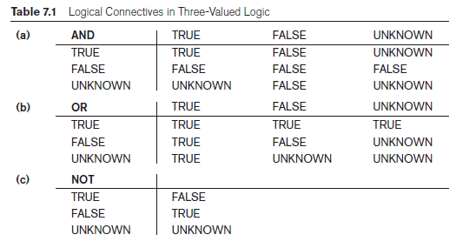
More Complex SQL Retrieval Queries
Comparisons Involving NULL and Three-Valued Logic

Slide 6
More Complex SQL Retrieval Queries
Comparisons Involving NULL and Three-Valued Logic
SQL allows queries that check whether an attribute value is NULL.
Rather than using = or <> to compare an attribute value to NULL, SQL uses the comparison operators “IS” or “IS NOT”.
This is because SQL considers each NULL value as being distinct from every other NULL value, so equality comparison is not appropriate.

Slide 7
More Complex SQL Retrieval Queries
Comparisons Involving NULL and Three-Valued Logic
Query 18. Retrieve the names of all employees who do not have supervisors.
Q18: SELECT Fname, Lname
FROM EMPLOYEE
WHERE Super_ssn IS NULL;

Slide 8
More Complex SQL Retrieval Queries
Subqueries
A Subquery or Inner query or a Nested query is a query within another SQL query and embedded within the WHERE clause.
Subqueries can be used with the SELECT, FROM, WHERE, INSERT, UPDATE, and DELETE statements
They are used along with the operators like =, <, >, >=, <=, IN, ANY, SOME etc.
Subqueries must be enclosed within parentheses.
Subqueries that return more than one row can only be used with multiple value operators such as the IN operator.

Slide 9
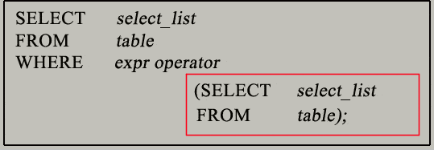
More Complex SQL Retrieval Queries
Subqueries
Why use subqueries?
Compare an expression to the result of the query.
Determine if an expression is included in the results of the query.
Execution follows Bottom – Top Approach i.e. inner query executes first.
The main query (outer query) use the subquery result.

Slide 10
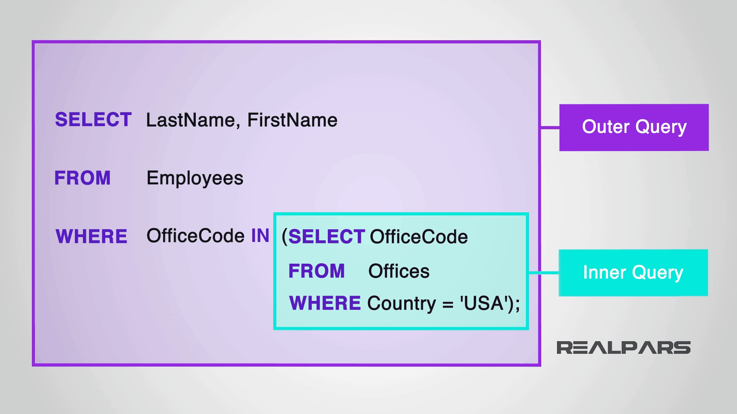
More Complex SQL Retrieval Queries
Subqueries

Slide 11
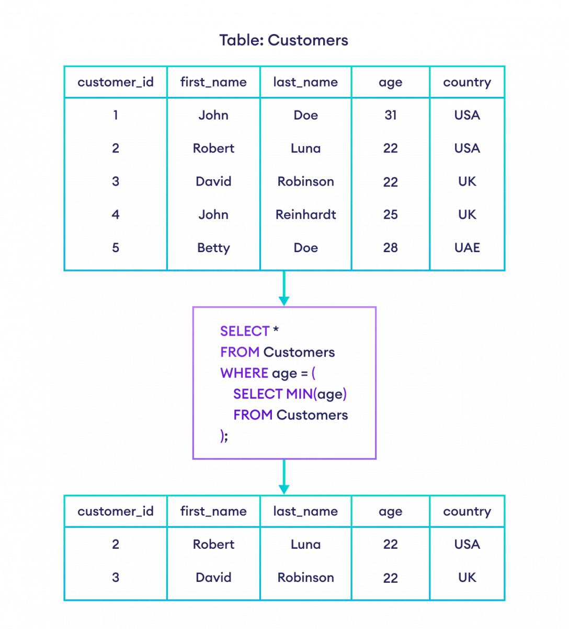
More Complex SQL Retrieval Queries
Subqueries

Slide 12
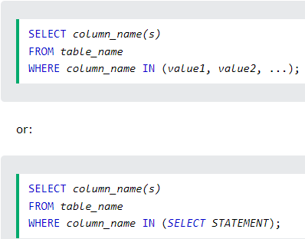
More Complex SQL Retrieval Queries
Nested Queries, Tuples, and Set/Multiset Comparisons
IN Operator (comparison operator)
which compares a value v1 with a set (or multiset) of values V and evaluates to TRUE if v1 is one of the elements in V.
The IN operator allows you to specify multiple values in a WHERE clause.
The IN operator is a shorthand for multiple OR conditions.

Slide 13
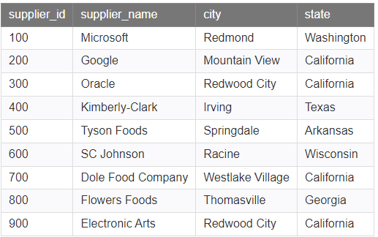
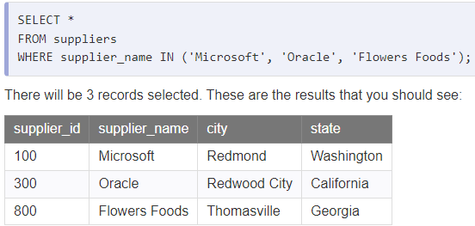
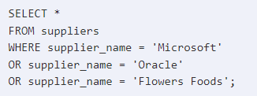
More Complex SQL Retrieval Queries
Nested Queries, Tuples, and Set/Multiset Comparisons
IN Operator

Slide 14
More Complex SQL Retrieval Queries
Nested Queries, Tuples, and Set/Multiset Comparisons
IN Operator
Query: Find the name of employees who are working on a project.
So, first it’ll fetch employees who are working on a project
Select Eid From Project
Project Table | Project Table
Eid | Pid | Pname | Location
1 | P1 | IoT | Ohio
5 | P2 | AI | Los Angeles
3 | P3 | Cloud | Chicago
4 | P4 | Android | Texas
Employee Table | Employee Table
Eid | Ename | Address
1 | Brown | New York
2 | Sam | Houston
3 | Smith | Seattle
4 | John | Denver
5 | Mary | San Francisco

Slide 15
More Complex SQL Retrieval Queries
Nested Queries, Tuples, and Set/Multiset Comparisons
IN Operator
Query: Find the name of employees who are working on a project.
Select Ename
From Employee
Where Eid IN (Select Eid From Project )
Compare Eid from Employee table with Project Table. Check if that Eid exists IN Project Table.
Comparison is done one by one for the complete table.
Employee Table | Employee Table
Eid | Ename | Address
1 | Brown | New York
2 | Sam | Houston
3 | Smith | Seattle
4 | John | Denver
5 | Mary | San Francisco
Project Table | Project Table
Eid | Pid | Pname | Location
1 | P1 | IoT | Ohio
5 | P2 | AI | Los Angeles
3 | P3 | Cloud | Chicago
4 | P4 | Android | Texas

Slide 16
More Complex SQL Retrieval Queries
Nested Queries, Tuples, and Set/Multiset Comparisons
NOT IN Operator
Query: Find the name of employees who are not working on a project.
Select Ename
From Employee
Where Eid NOT IN (Select Eid From Project )
Compare Eid from Employee table with Project Table. Check if that Eid exists IN Project Table.
Comparison is done one by one for the complete table.
Employee Table | Employee Table
Eid | Ename | Address
1 | Brown | New York
2 | Sam | Houston
3 | Smith | Seattle
4 | John | Denver
5 | Mary | San Francisco
Project Table | Project Table
Eid | Pid | Pname | Location
1 | P1 | IoT | Ohio
5 | P2 | AI | Los Angeles
3 | P3 | Cloud | Chicago
4 | P4 | Android | Texas

Slide 17
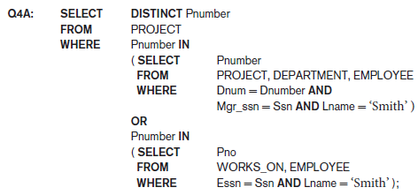
More Complex SQL Retrieval Queries
Nested Queries, Tuples, and Set/Multiset Comparisons
In Q4A:
the first nested query selects the project numbers of projects that have an employee with last name ‘Smith’ involved as manager,
whereas the second nested query selects the project numbers of projects that have an employee with last name ‘Smith’ involved as worker.
In the outer query, we use the OR logical connective to retrieve a PROJECT tuple if the PNUMBER value of that tuple is in the result of either nested query.

Slide 18
More Complex SQL Retrieval Queries
Nested Queries, Tuples, and Set/Multiset Comparisons
If a nested query returns a single attribute and a single tuple, the query result will be a single (scalar) value.
In such cases, it is permissible to use = instead of IN for the comparison operator.

Slide 19

More Complex SQL Retrieval Queries
Nested Queries, Tuples, and Set/Multiset Comparisons
SQL allows the use of tuples of values in comparisons by placing them within parentheses.
This query will select the Essns of all employees who work the same (project, hours) combination on some project that employee ‘John Smith’ (whose Ssn = ‘123456789’) works on.
In this example, the IN operator compares the sub tuple of values in parentheses (Pno, Hours) within each tuple in WORKS_ON with the set of type-compatible tuples produced by the nested query.

Slide 20
More Complex SQL Retrieval Queries
Nested Queries, Tuples, and Set/Multiset Comparisons
Several other comparison operators can be used to compare a single value v1 to a set or multiset V (typically a nested query).
The = ANY (or = SOME) operator returns TRUE if the value v1 is equal to some value in the set V and is hence equivalent to IN.
Other operators that can be combined with ANY (or SOME) include >, >=, <, <=, and <>.

Slide 21
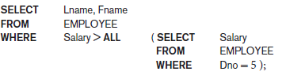
More Complex SQL Retrieval Queries
Nested Queries, Tuples, and Set/Multiset Comparisons
The keyword ALL can also be combined with each of these operators.
For example, the comparison condition (v > ALL V) returns TRUE if the value v is greater than all the values in the set (or multiset) V.
An example is the query, which returns the names of employees whose salary is greater than the salary of all the employees in department 5.

Slide 22
More Complex SQL Retrieval Queries
Nested Queries, Tuples, and Set/Multiset Comparisons
AMBIGUITY ISSUE
Ambiguity among attribute names if attributes of the same name exist—one in a relation in the FROM clause of the outer query, and another in a relation in the FROM clause of the nested query.
To refer to an attribute of the relation specified in the outer query, we specify and refer to an alias (tuple variable) for that relation.

Slide 23
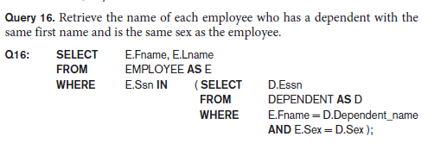
More Complex SQL Retrieval Queries
Nested Queries, Tuples, and Set/Multiset Comparisons
AMBIGUITY ISSUE
In the nested query of Q16, we must qualify E.Sex because it refers to the Sex attribute of EMPLOYEE from the outer query, and DEPENDENT also has an attribute called Sex.
If there were any unqualified references to Sex in the nested query, they would refer to the Sex attribute of DEPENDENT.
However, we would not have to qualify the attributes Fname and Ssn of EMPLOYEE if they appeared in the nested query because the DEPENDENT relation does not have attributes called Fname and Ssn, so there is no ambiguity.

Slide 24
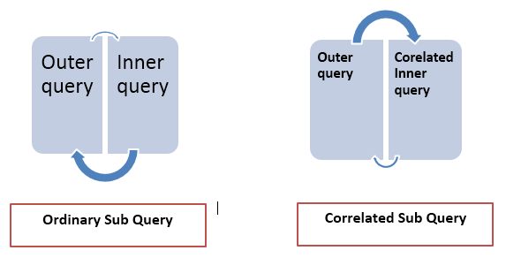
More Complex SQL Retrieval Queries
Correlated Nested Queries
Correlated subqueries are used for row-by-row processing.
Each subquery is executed once for every row of the outer query.
The parent statement can be a SELECT, UPDATE, or DELETE statement.

Slide 25
More Complex SQL Retrieval Queries
Correlated Nested Queries
A correlated subquery is one way of reading every row in a table and comparing values in each row against related data.
Nested Subqueries Versus Correlated Subqueries :
With a normal nested subquery, the inner SELECT query runs first and executes once, returning values to be used by the main query.
A correlated subquery, however, executes once for each candidate row considered by the outer query. In other words, the inner query is driven by the outer query.
NOTE : You can also use the ANY and ALL operator in a correlated subquery.

Slide 26
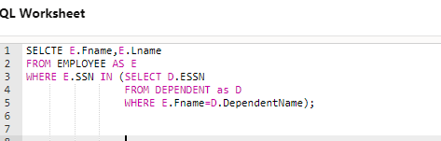
More Complex SQL Retrieval Queries
Correlated Nested Queries
Whenever a condition in the WHERE clause of a nested query references some attribute of a relation declared in the outer query, the two queries are said to be correlated.
For example, we can think of Q16 as follows:
For each EMPLOYEE tuple, evaluate the nested query, which retrieves the Essn values for all DEPENDENT tuples with the same name as that EMPLOYEE tuple; if the Ssn value of the EMPLOYEE tuple is in the result of the nested query, then select that EMPLOYEE tuple.

Slide 27
More Complex SQL Retrieval Queries
The EXISTS Function in SQL
EXISTS is a Boolean functions that return TRUE or FALSE.
Can be used in a WHERE clause condition.
EXISTS function: used to check whether the result of a nested query is empty (contains no tuples) or not.
The result of:
EXISTS = TRUE; if the nested query result contains at least one tuple,
EXISTS= FALSE if the nested query result contains no tuples.
EXISTS and NOT EXISTS are typically used in conjunction with a correlated nested query.

Slide 28
More Complex SQL Retrieval Queries
The EXISTS Function in SQL
EXISTS Operator
Query: Find the detail of employee who is atleast working on a project.
Select * From Employee
Where EXISTS (Select Eid from Project
Where Employee.Eid = ProjectEid)
Eid in employee table compared with employee id in project table.
If match is found then TRUE, select that row.
Project Table | Project Table
Eid | Pid | Pname | Location
1 | P1 | IoT | Ohio
5 | P2 | AI | Los Angeles
3 | P3 | Cloud | Chicago
4 | P4 | Android | Texas
Employee Table | Employee Table
Eid | Ename | Address
1 | Brown | New York
2 | Sam | Houston
3 | Smith | Seattle
4 | John | Denver
5 | Mary | San Francisco

Slide 29
More Complex SQL Retrieval Queries
The EXISTS Function in SQL
NOT EXISTS Operator
Query: Find the detail of employee who is not working on a project.
Select * From Employee
Where NOT EXISTS (Select Eid from Project
Where Employee.Eid = Project.Eid)
Eid in employee table compared with employee id in project table.
If match is not found then TRUE, select that row.
Project Table | Project Table
Eid | Pid | Pname | Location
1 | P1 | IoT | Ohio
5 | P2 | AI | Los Angeles
3 | P3 | Cloud | Chicago
4 | P4 | Android | Texas
Employee Table | Employee Table
Eid | Ename | Address
1 | Brown | New York
2 | Sam | Houston
3 | Smith | Seattle
4 | John | Denver
5 | Mary | San Francisco

Slide 30
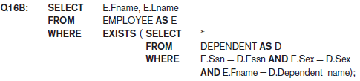
More Complex SQL Retrieval Queries
The EXISTS Function in SQL
In Q16B, the nested query references the Ssn, Fname, and Sex attributes of the EMPLOYEE relation from the outer query.
For each EMPLOYEE tuple, evaluate the nested query, which retrieves all DEPENDENT tuples with the same Essn, Sex, and Dependent_name as the EMPLOYEE tuple; if at least one tuple EXISTS in the result of the nested query, then select that EMPLOYEE tuple.
EXISTS(Q) returns TRUE if there is at least one tuple in the result of the nested query, and returns FALSE otherwise.

Slide 31
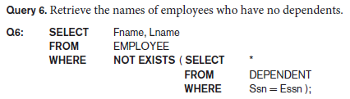
More Complex SQL Retrieval Queries
The EXISTS Function in SQL
NOT EXISTS(Q) returns TRUE if there are no tuples in the result of nested query Q, and returns FALSE otherwise.
In Q6, the correlated nested query retrieves all DEPENDENT tuples related to a particular EMPLOYEE tuple.
If none exist, the EMPLOYEE tuple is selected because the WHERE-clause condition will evaluate to TRUE in this case.
Q6 as follows: For each EMPLOYEE tuple, the correlated nested query selects all DEPENDENT tuples whose Essn value matches the EMPLOYEE Ssn; if the result is empty, no dependents are related to the employee, so we select that EMPLOYEE tuple and retrieve its Fname and Lname.

Slide 32
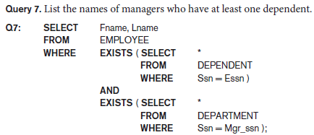
More Complex SQL Retrieval Queries
The EXISTS Function in SQL
One way to write this query is shown in Q7, where we specify two nested correlated queries.
The first selects all DEPENDENT tuples related to an EMPLOYEE, and the second selects all DEPARTMENT tuples managed by the EMPLOYEE.
If at least one of the first and at least one of the second exists, we select the EMPLOYEE tuple. First checks the dependents are NULL & then check the person is manager

Slide 33
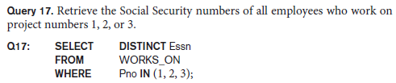

More Complex SQL Retrieval Queries
Explicit Sets and Renaming in SQL
It is also possible to use an explicit set of values in the WHERE clause, rather than a nested query. Such a set is enclosed in parentheses in SQL.
In SQL, it is possible to rename any attribute that appears in the result of a query by adding the qualifier AS followed by the desired new name.
Hence, the AS construct can be used to alias both attribute and relation names in general, and it can be used in appropriate parts of a query.

